Slide 1
Retirement
1
Capital
SSAS
A Pension for Business Owners
https://retirement.capital info@retirement.capital

Slide 2
1
Paul Davies - Partner at Retirement Capital
I have over 28 years experience in Financial Services with a strong Pension Bias.
I have worked for Pearl Assurance, Lloyds Bank, Legal & General and eventually set up my own Financial Planning business which I sold to St James Place in 2015.
I hold the Diploma in Regulated Financial Advice from the Personal Finance Society.
I was invited to join RC back in 2017 and have set up and administered over 250 SSAS Pensions in that time.
I am married to Louise, have 2 grown up children and have 3 dogs!
I am ashamed to say that during my career in Financial Services that SSAS was often overlooked as a solution - something I am keen to put right!

Slide 3
1
What is SSAS?
Small Self Adminiistered Scheme
Set up by a Limited Company to provide Pension benefits to its Directors and their family members.
Each SSAS is Registered with HMRC and thus benefits from the generous tax reliefs that are afforded to Pensions.
You must have a trading company and be a director (or LLP) to have a SSAS
SSAS tends to favour Property investment because of the flexibility on investment choices.
YOU are the trustee of your own scheme so have far greater control and flexibility than you would with say a SIPP or Workplace pension.
SASS is NOT for everyone!

Slide 4
1
How does SSAS Work?
It allows you to build up a tax free Pot of cash.
You can transfer in any old Pensions you have.
Your Company can make contributions and in doing so reduce its Corporation Tax bill.
You can also make Personal Contributions and receive Tax Relief.
YOU as the TRUSTEE of your SSAS can then make investment decisions around where to invest and get a return on your money.
You can access a huge range of investments, from the more traditional Stocks and Shares, Investment Funds through to the more sophisticated such as loans to Companies or even direct Commercial Property / Land purchase!

Slide 5
1
With Great Power comes Great Responsibility!
As TRUSTEE you need to act prudently and have the end goal in sight!
You have huge Control and Flexibility - but please do your Own Due Dilligence and remember if an investment seems too good to be true then it probably is!

Slide 6
1
SSAS Property Investment
10 KEYS
Allows you to acquire Commercial property under the SSAS and is very tax efficient.
You can get a commercial mortgage of 50% of the value of the fund
You can transfer most other pensions in to help build your fund
You can purchase commercial, industrial land & property
Residential property, unless it is part an exempt fund or is an exempt property (caretakers flat) cannot be held
Rents are paid to the pension bank account, used to pay down the mortgage or grow the fund.
Property sold on attracts zero capital gains tax
Property income exempt from income tax
You can Joint Venture with your business on a property project.
Property held within the SSAS can be passed on to Family without IHT.

Slide 7
1
CASE STUDY = REDUCE COMPANY TAX
Fred has around £100,000 built up as cash reserves in his business and needs to keep operating cash of £30,000.
He has taxable profits in his business each year of around £60,000.
Fred sets up a SSAS with Retirement Capital, who consult with him and his accountant on ensuring it is the right fit for his taxation and business requirements.
Fred contributes £50,000 from his business, this reduces his tax bill from £11,400 to £1900 for the year.
Fred now has £50,000 in his pension scheme bank account.
Fred has a pension from a previous pension scheme of £50,000 and after taking regulated financial advice transfers this money to the SSAS.
There is now £100,000 in his pension bank account.

Slide 8
1
CASE STUDY = MAINTAIN BUSINESS CASH FLOW
Fred has seen a house with the potential to extend and the seller will accept for a cash sale £97,000.
Fred, after getting a survey and assessment, estimates that with building works and re-financing of £34500 they can resell on for £175,000 as a house with multiple occupancy.
Fred uses Retirement Capital SSAS consultant to tax register his SSAS and set up the loan from his SSAS.
SSAS lends £48,500 into Fred’s Property Company, leaving the balance to be funded as a commercial re-financing mortgage from Alderhouse Bank. Alderhouse Bank has a 1st charge on the property.
The pension scheme loan of £48500 is secured against Fred’s plumbing business and Fred’s SSAS charges 5% interest on the loan.

Slide 9
1
CASE STUDY = USE SSAS LOAN TO CREATE PROFIT IN THE BUSINESS
NET OUTCOME
Property Sale Price £175,000
Less
Property Purchase : £97,000
Costs and Refinance: £34,000
Less interest charge by SSAS: £2400
Profit in the Business: £43,000
Remember: Fred’s company earned £9,500 in business tax relief at outset

Slide 10
Retirement
1
Capital
Why Now
"A game changer for pensions”
https://retirement.capital info@retirement.capital

Slide 11
Unlike other SSAS Pension providers…
Retirement Capital aggregates all your investments i.e. property,
Stocks and shares, cash deposits etc..
Added to 1 platform which is centrally managed and administered
Allows investment via a single gateway
Totally cloud based
Totally accessible online and via your mobile phone
Will be scaled throughout the UK in 2023
1

Slide 12
1
This summer we will be rolling out a series of demonstrations and webinars
on adding rocket fuel to your
Retirement Capital for a secure and better future.
A SSAS consulting team will give nationwide talks with ideas and help.

Slide 13
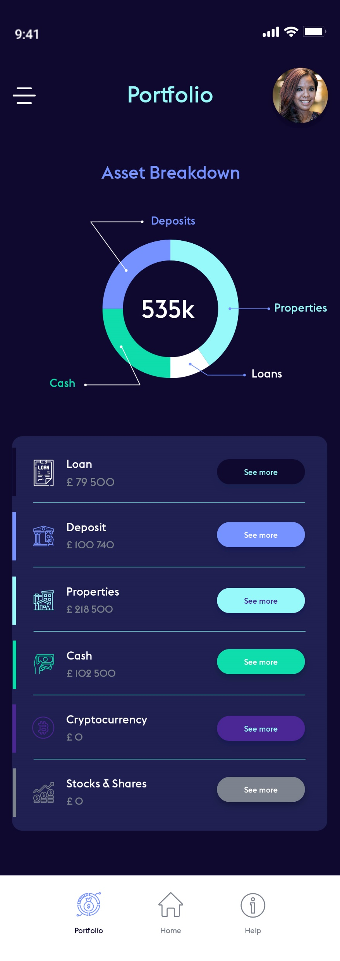
1
Retirement Capital is a Partnership
Registered Administrator
RC Administration Limited Member of AMPS, Fit and Proper Recognised by HMRC
2. Regulated Financial Services
RC Financial LLP FCA Regulated to provide investment services
3. Fintech Development and Technology
Retirement Capital Applications LLC
Provide full cycle tech delivery to UK customers.

Slide 14
Retirement
1
Capital
THANK YOU
"A game changer for pensions”
https://retirement.capital info@retirement.capital

